Slide 1
YouTube Trending Analytics
IDS 561
Analytics for Big Data
Submitted by -
David Kern
Debdeep Ghosh
Karan Gujrati

Slide 2
Introduction
YouTube is the biggest video-sharing platform, with about 70,000 years of videos available. People watch more than one billion hours of videos everyday - that’s more than they watch Netflix and Facebook videos combined.
YouTubers often resort to ‘clickbait’ titles in an attempt to gain views
Can changing the wording of the title affect viewership? Can it spur interaction such as likes/dislikes/comments?
We began by examining the reduced dataset of only the US trending list, and then went on to see how the results compare to other countries such as Great Britain.

Slide 3
Dataset
The dataset is picked up from a Kaggle non-competition set. 500 MB of CSV files with video analytics (length, likes, views, etc.) and some text data (tags, video description, etc.). Here is the link - https://www.kaggle.com/datasnaek/youtube-new
The data was originally taken from YouTube API in 2019. This is slightly out of date but should still be relevant.
US and UK trending lists were of a similar size (roughly 40k videos each)
Data included 3 text fields which the user could control: Title, Description, and Tags.

Slide 4
Techniques Used
Sentiment analysis on the video description, title, and tags. This used the python library TextBlob.
Chose engagement statistics (views, likes per view, likes per dislike, comments per view)
Spearman ranked correlation between these engagement statistics and sentiment polarity of each text field

Slide 5
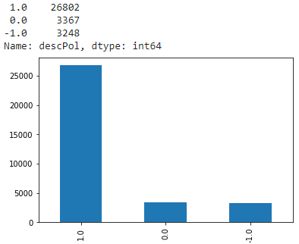
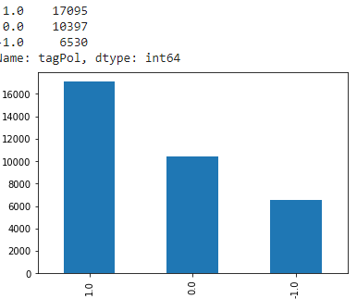
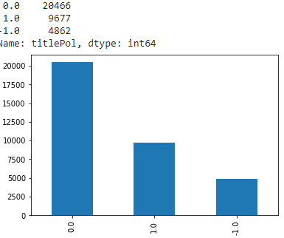
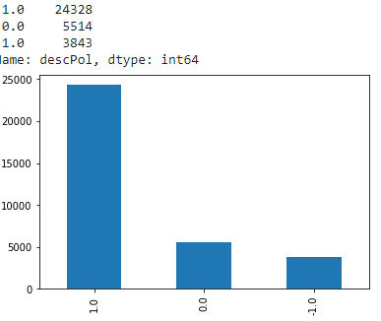
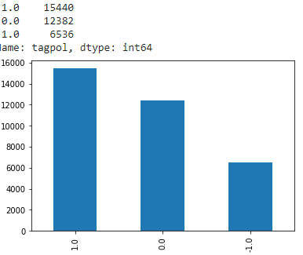
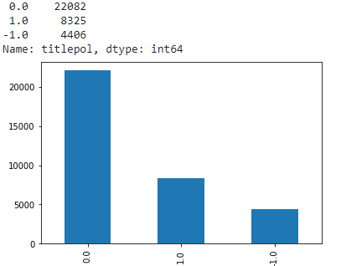
Histograms for Sentiments
 | Description | Tags | Title
US
UK

Slide 6
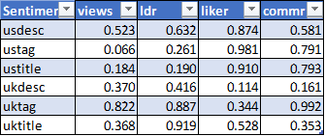
Results
No p values are low enough for statistical significance
US values are better for tag and title, UK for description
US tag sentiment could be correlated with views, p value is almost .05
This correlation was negative, hinting at a possible preference for bad sentiment

